Slide 1
Reconfigurable SoC-Based Smart sensor for wavelet and wavelet packet analysis
Igor Peric
Daniel Barmaimon

Slide 2
Index
Introduction
Theoretical Background
Smart Sensor Implementation
Experimentation and Results
Conclusion

Slide 3
Monitoring Systems Needs
High-Performance
Layout
Low-cost primary sensors
Introduction
Theoretical Background
Online signal processing
Smart Sensor Implementation
Experimental Data and Results
SoC – System on Chip
Conclusions

Slide 4
Monitoring Systems Needs
High-Performance
Layout
Low-cost primary sensors
Introduction
Theoretical Background
Online signal processing
Smart Sensor Implementation
Experimental Data and Results
SoC – System on Chip
Conclusions
Applications during last year
Flavor analysis for liquids
Detecting hydrogen leaks and [Nox]
DC power grid protection
High resolution frequency estimation
Machine fault diagnosis

Slide 5
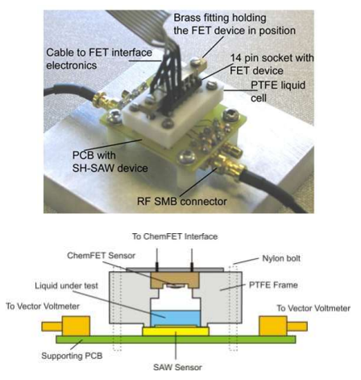
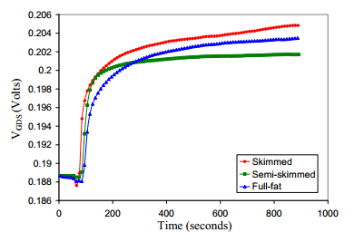
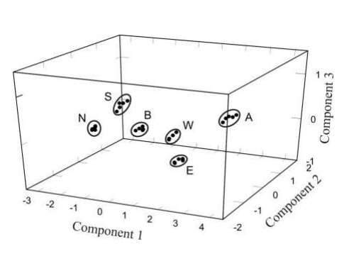
Monitoring Systems Needs
High-Performance
Layout
Low-cost primary sensors
Introduction
Theoretical Background
Online signal processing
Smart Sensor Implementation
Experimental Data and Results
SoC – System on Chip
Conclusions
Applications during last year
Flavor analysis for liquids
Detecting hydrogen leaks and [Nox]
DC power grid protection
High resolution frequency estimation
Machine fault diagnosis

Slide 6
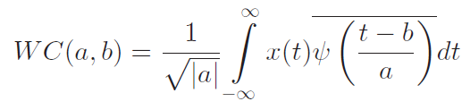
Wavelet Transformation (WT)
Layout
Continuous WT is defined through the wavelet coefficients (WC)
Introduction
ψ(t) = Mother wavelet function
x(t) = Signal to process
Theoretical Background
a = Time scale
b = Shift of scaled mother wavelet function
Smart Sensor Implementation
Experimental Data and Results
Conclusions

Slide 7
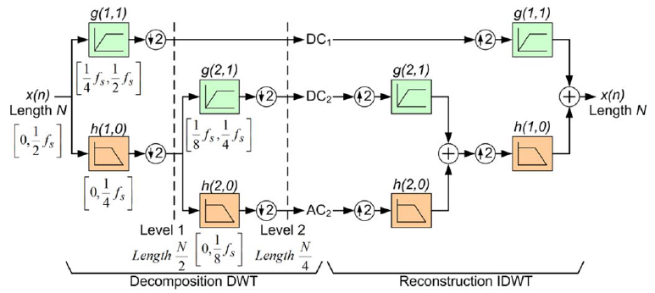
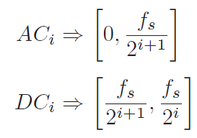
Wavelet Transformation (WT)
Layout
Continuous WT is defined through the wavelet coefficients (WC)
Introduction
ψ(t) = Mother wavelet function
x(t) = Signal to process
Theoretical Background
a = Time scale
b = Shift of scaled mother wavelet function
Smart Sensor Implementation
Experimental Data and Results
Discrete Wavelet Transformation (DWT)
Conclusions
Uses dicrete time low- and high-pass filters, h(i,j) and g(i,j), followed by downsampling operation for each decomposition level

Slide 8
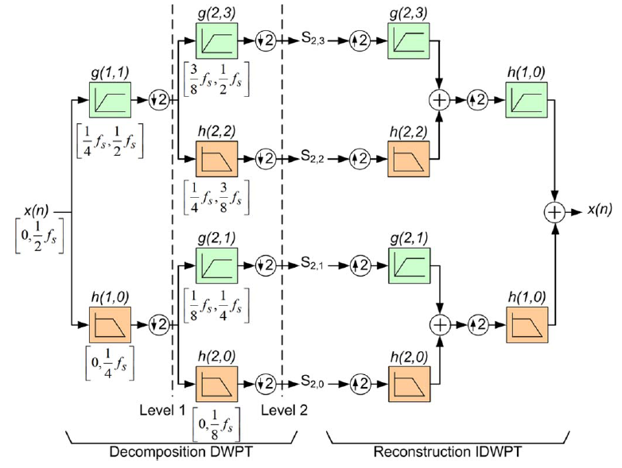
Discrete Wavelet PacketTransformation (DWPT)
Layout
Detailed and approximation coefficient are calculated for low and high frequency bands is the only difference with respect to DWT.
Introduction
Theoretical Background
Smart Sensor Implementation
Experimental Data and Results
Conclusions

Slide 9
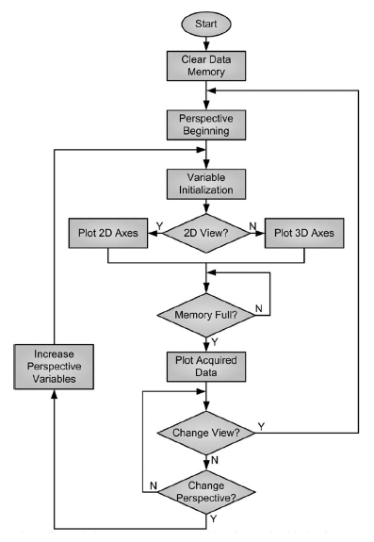
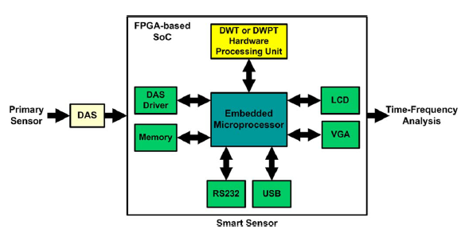
Signal processing
A smart sensor provides
to the primary sensor
Communication capabilities
Layout
Introduction
Theoretical Background
Smart Sensor Implementation
Experimental Data and Results
Conclusions
Notes:
DAS – Collect the data
Micro – Information Exchange
Hardware Unit – DWT or DWPT
Memory – Temporal storage of information
LCD, VGA, USB, RS232 – Display data or connect to PC

Slide 10

Signal processing
A smart sensor provides
to the primary sensor
Communication capabilities
Layout
Introduction
1.- Embedded microprocessor
Theoretical Background
8-bit Harvard-arquitectura microprocessor
Smart Sensor Implementation
Customized for register transference and interrupt management
Experimental Data and Results
It will speed up program execution and reduce power consumption
Conclusions
Main task: Coordinate information exchange between components

Slide 11

Signal processing
A smart sensor provides
to the primary sensor
Communication capabilities
Layout
Introduction
2.- DWT or DWPT Harware Processing Unit
Theoretical Background
8-bit Harvard-arquitectura microprocessor
Smart Sensor Implementation
Customized for register transference and interrupt management
Experimental Data and Results
It will speed up program execution and reduce power consumption
Conclusions
Main task: Coordinate information exchange between components

